Slide 1


Gas Leakage
Safety System
PROJECT REPORT for ELECTIVE PROJECT AND COMPUTATION - I
Department Of Electrical Engineering
Jadavpur University

Slide 2








Aim:
In countries like India due to extreme negligence towards safety, thousands of people die due to accidents every year, both inside and outside their homes. A leading cause of accidents in homes is fire due to LPG gas leakage from cooking cylinders.
Gas knobs are sometimes accidentally left open, or there are cracks in the gas pipe that often go undetected. Elevated temperatures or sparks from nearby circuitry can set this gas on fire, which leads to explosion of the gas cylinder. Exploding cooking gas cylinders accounted for nearly one-sixth of all deaths from accidental fires between 2010 to 2014, with a total of 19,491 deaths and thousands of severe burn victims. Hence it's important to address this issue and develop an economically feasible solution to prevent these accidents.
Notes:
working principle next

Slide 3



Working Principle:
Our system aims to prevent gas leakage accidents by:
▪ detecting the gas leaks with the help of an MQ-2 gas sensor module compatible with Arduino (Microcontroller Atmega328p).
▪ sealing off the gas source with the help of a servo motor.
▪ alerting the owner about the leak via SMS that requires no internet connectivity.
▪ releasing the leaked gases outside the house by switching on the existing exhaust fan or chimney.
Notes:
flowchart next

Slide 4

Flowchart:
START
Amount of gas in air (from MQ2)
No
Gas value > 400 ppm
Yes
Servo Motor rotates & blocks the path of the gas
Alert user
Turns on Exhaust fan/Chimney
STOP
Notes:
mq2 sensor next

Slide 5

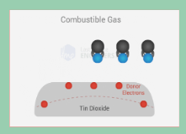
Detailed Working Principle:
For detection of the gas we have used the MQ-2 gas sensor module compatible with Arduino (Microcontroller Atmega328p).
The MQ-2 gas sensor module which is a chemiresistor has been used to detect the leakage of the LPG gas. The sensing element of the sensor is mainly aluminium-oxide based ceramic, coated with Tin dioxide, enclosed in a stainless-steel mesh. Sensing element has six connecting legs attached to it. Two leads are responsible for heating the sensing element, the other four are used for output signals. Oxygen gets adsorbed on the surface of sensing material when it is heated in air at high temperature. Then donor electrons present in tin oxide are attracted towards this oxygen, thus preventing the current flow.
When reducing gases are present, these oxygen atoms react with the reducing gases thereby decreasing the surface density of the adsorbed oxygen. Now current can flow through the sensor, which generates analog voltage values. These voltage values are measured to know the concentration of gas. Voltage values are higher when the concentration of gas is high.
Generally, at a concentration of 2000 ppm the LPG gas is considered to be dangerous due to risk of explosion. The module detects a concentration of 300-10000 ppm of combustible gas and it requires a power source of 4.5V to 5V DC and can be directly powered from the Arduino board. For the circuit we have kept the leakage detection threshold as 1.95V. The output value of the sensor has been sent as an input to the micro controller; therefore, as soon as the value of combustible gas in air goes above the threshold the microcontroller sends signals three units:
to the servo motor to close and shut off the supply of the gas through the connector,
to the gsm module to send an alert SMS to the users' mobile phone and
to the relay switch to turn on the exhaust fan or chimney of the kitchen.
For better safety and avoid any mishaps we have used two gas sensors one outside the cylinder cabinet (to detect gas leakage from the stove) and one inside to detect internal gas leakage (Leakage in pipe).

Slide 6
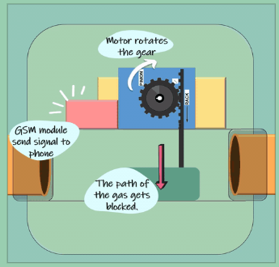
Detailed Working Principle:
Working Principle of the output units are as follows:
Servo Motor and Connector: The servo motor is connected to a “Rack and Pinion” type system. When the sensor detects gas, the Arduino sends a signal to the servo motor to rotate. As the motor rotates the rack and pinion system closes the path of the gas in the connector and thus any further leakage is stopped. Servo motor is also powered by the Arduino 5V pin.

Slide 7
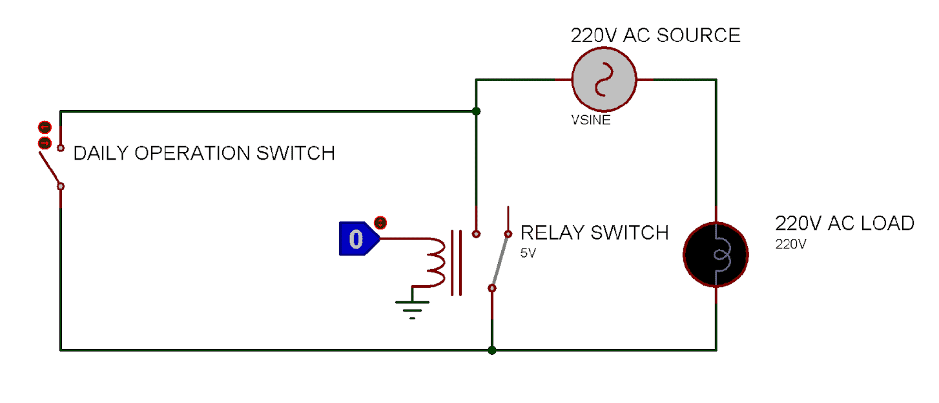
Detailed Working Principle:
GSM Module: The SIM 900 series of the available GSM Modules has been used. These modules require a maximum of 2A of current with a DC supply voltage of 3.4V to 4.5V while sending an SMS or calling. 5V-12V supply can be used with linear voltage divider. Rechargeable Li-on cells are used to power the module as well as the whole setup, to supply high current. The SIM 900 modules are very easy to use and after placing the SIM and connecting with the Arduino board the configuration can directly be done when the code runs. After the detection of the gas the Arduino sends commands to the SIM Module to send SMS to the user. It takes the module 3 to 5 seconds to send SMS to the user.
●Relay switch and exhaust fan: A single channel 5V relay switch with Max Switching voltage of 250V and max switching current of 10 ampere has been used. The relay switch requires an input voltage of 5V and a few milliamperes and can be directly powered by the Arduino. The relay switch is connected with the exhaust fan/chimney of the kitchen. As we know that the exhaust fan will be required for daily usage purpose, the relay switch connection will be in parallel with the daily operation switch so that the exhaust fan works according to the adjacent table and circuit:
Relay Switch | Daily Operation Switch | Exhaust Fan
ON | OFF | ON
OFF | ON | ON
ON | ON | ON
OFF | OFF | OFF
SIGNAL FROM ARDUINO

Slide 8


Comparison with existing commercial systems:
Pros of using our system:
▪ Comes at an affordable price
▪ Easy to install. Does not require a lot of changes in the existing system for setting up.
▪ Works on batteries and uses minimal wires, has a hassle-free compact design
Cons of using existing gas leakage detection system:
Other commercially existing systems serve only the purpose of alerting, using an LED or buzzer which is only useful if the user is near the system. Our system can send SMS and alert the user, no matter where he is.
Existing systems perform only one function which is to alert the user, whereas our system not only alerts the user but also prevents the accident by 1) venting out the gas 2) blocking the path of the gas, thereby stopping further leakage
Most existing systems use MQ-6 sensors which can't differentiate between smoke and inflammable gases and may lead to false alert if smoky food is cooked. We have used the sensitive MQ-2 gas sensor which can detect reducing gases in air from 200-10000 ppm. The sensor is very sensitive and has a fast response.
Commercially available systems use the concept of pressure to jam the knob but are not very reliant.

Slide 9





Hardware

Slide 10


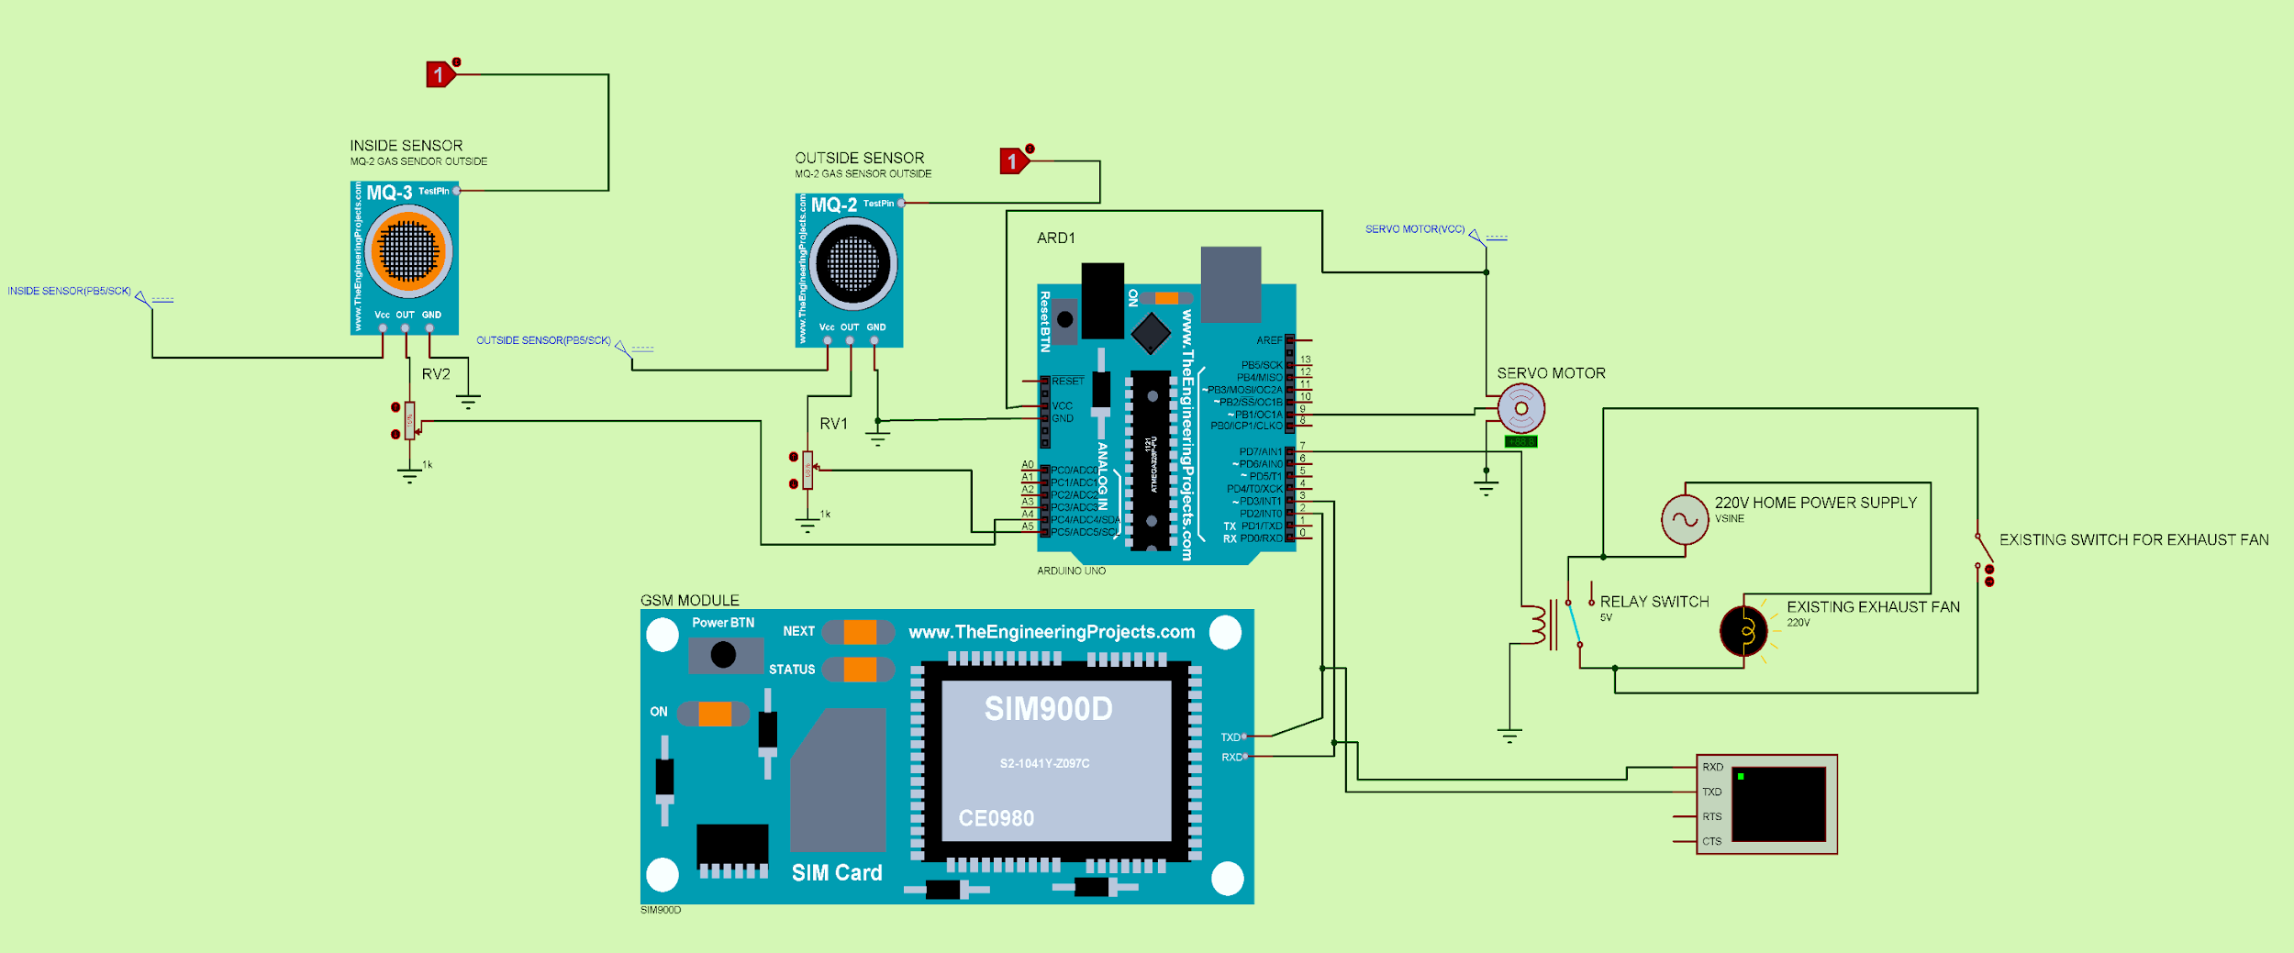
Circuit digram
Circuit Diagram (Wired):

Slide 11
Wired System Cost Estimation
Component | Quantity | Cost per pc | Amount | Amount (excl. GST) | Buying Links
MQ-2 Sensor | 2 | 110 | ₹220.00 | ₹186.44 | Link
Servo Motor | 1 | 77 | ₹77.00 | ₹65.25 | Link
Arduino Uno | 1 | 265 | ₹265.00 | ₹224.58 | Link
SIM-800L GSM Module | 1 | 345 | ₹345.00 | ₹292.37 | Link
9V battery | 1 | 10 | ₹10.00 | ₹8.47 | Link
Relay Switch | 1 | 62 | ₹62.00 | ₹52.54 | Link
Casing,Jumper wires, Resistors, Capacitors | -------- | --------- | ₹40.00 | ₹33.90 | -
Safety Connector | 1 | 25 | ₹25.00 | ₹21.19 | -
Total: |  |  | ₹1,044.00 | ₹884.75
Additional Cost for Wireless system (optional)
Arduino Nano | 1 | 175 | ₹175.00 | ₹148.31 | Link
HC-05 Bluetooth Module | 2 | 195 | ₹390.00 | ₹330.51 | Link
Total including all: |  |  | ₹1,609.00 | ₹1,363.56

Slide 12
Thank You!
Reference Links:
News Source: here
Bluetooth Configuration: here
Gas sensor datasheet: here
GSM Module datasheet: here

